Slide 1
Image Processing using Raspberry Pi

Slide 2

The team
Harshith J – 1BM14EC035
Balaji Gorental – 1BM14EC034
Diganth P – 1BM14EC028
Dheeraj Kamath – 1BM14EC027

Slide 3
Contents
01
Project Overview
02
Setting up the raspberry pi
03
Image Processing
04
Results

Slide 4
Project Overview
1
What you can expect...

Slide 5
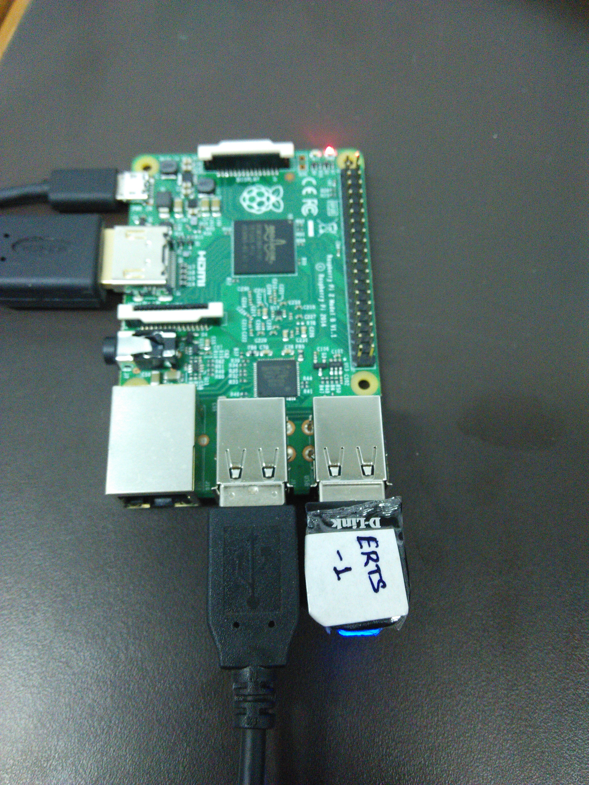

The Plan
Aruco Marker
Raspberry Pi
Obtain Marker
Image
Final Result
Perform Image Processing
Marker ID

Slide 6
Topics Covered
Image Processing using Python
Linux Environment
Socket Programming
Hamming Algorithm
Barcode decoding mechanism

Slide 7
Setting up the Raspberry Pi
2
Let’s begin…

Slide 8
Components Required
HDMI Cable
Monitor
Keyboard
Mouse
Sd card
D-Link Wi-Fi Adapter

Slide 9
The Linux Environment
The Raspberry Pi (raspi) is based on the Linux OS. Following are the basic commands used:
sudo – for admin rights
nano – interface
cd (directory path) – For changing into another directory
chmod – creating new files
lsusb – to check devices connected to the raspi
ifconfig – for obtaining the ip address and other networking parameters

Slide 10
The Setup Flow
On start, the raspi goes through the following steps:
prompts for username and password
enter pi for username and raspberry for password
configure the settings as per requirement
type startx to launch the GUI
use Lx Terminal for further instructions or commands
use Python for the interfacing of the pi with other components.

Slide 11
Image Processing
3
Understanding various image processing terminolgies…

Slide 12
Image Processing in Python
The opencv (Computer Vision) library imported into Python is used for all the image processing programs.
The functions mainly used are:
cv2.threshold()
cv2.cvtColor()
cv2.findContours()
cv2.arcLength()
cv2.approxPolyDp()
Other morphological and transformational functions will be used too.

Slide 13
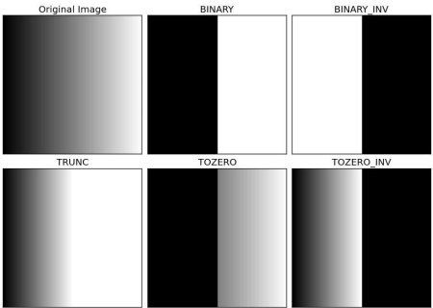
Thresholding
If pixel value is greater than a threshold value, it is assigned one value (may be white), else it is assigned another value (may be black).

Slide 14

Contours
Contours can be explained simply as a curve joining all the continuous points (along the boundary), having same color or intensity.

Slide 15
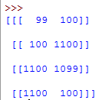
Approx Poly DP
Returns the coordinates of the boundary points.
(1100, 100)
(1100, 1100)
(100, 100)
(100, 1100)

Slide 16

Aruco Markers
An ArUco marker is a synthetic square marker composed by a wide black border and a inner binary matrix which determines its identifier (id).

Slide 17

Aruco Markers Breakdown
It is a 5x5 grid that is black and white in color.
In the grid:
the first, third and fifth columns represent parity bits.
The second and fourth columns represent the data bits.
Hence, there are ten total data bits. So the maximum number of markers that can be encoded are-
2^10 = 1024
Applications include Augmented Reality.

Slide 18

The Coding Technique
Step 1 : Extract the ArUco from the image.

Slide 19

The Coding Technique
Step 2 : Remove the extra padding.

Slide 20
The Coding Technique
Step 3 : Divide the resulting image into a 5x5 grid and check the color in each cell of the second and fourth columns(in that order) in a top to bottom manner.
1 | 0 | 0 | 0 | 0
0 | 1 | 1 | 1 | 0
1 | 0 | 0 | 0 | 0
1 | 0 | 0 | 0 | 0
1 | 0 | 0 | 0 | 0

Slide 21
The Coding Technique
Step 4 : If the color is white, write 1; else, write it 0.
Step 5 : The resulting number will be in binary. Convert it into decimal
This is how the id of the marker is determined.

Slide 22
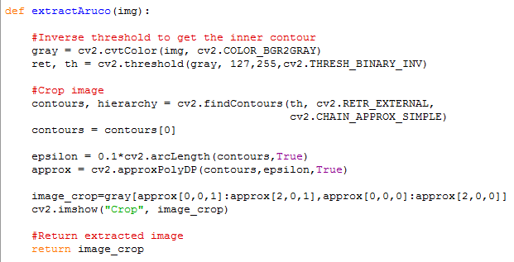
The final python code is defined using two functions:
arucoExtract(img) – Returns the required marker portion from the image
arucoDecode(marker_img) – Takes the marker image and returns the marker id

Slide 23
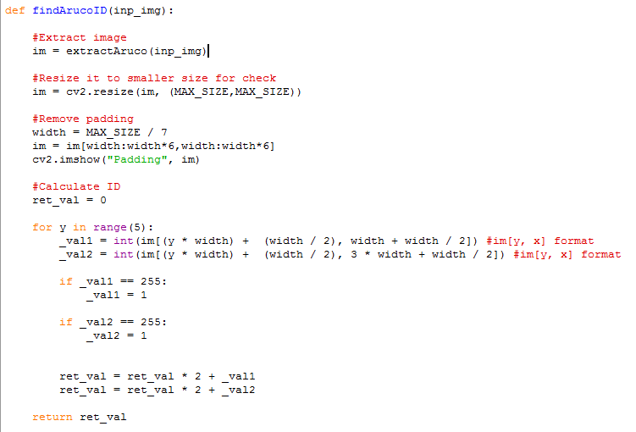

Slide 24
Results
4
Be prepared to be amazed…

Slide 25

Extracted Marker Image
Resized Marker Image
Final Output
👆👉👍👤👦👧👨👩👪💃🏃💑❤😂😉😋😒😭👶😸🐟🍒🍔💣📌📖🔨🎃🎈🎨🏈🏰🌏🔌🔑

Slide 26
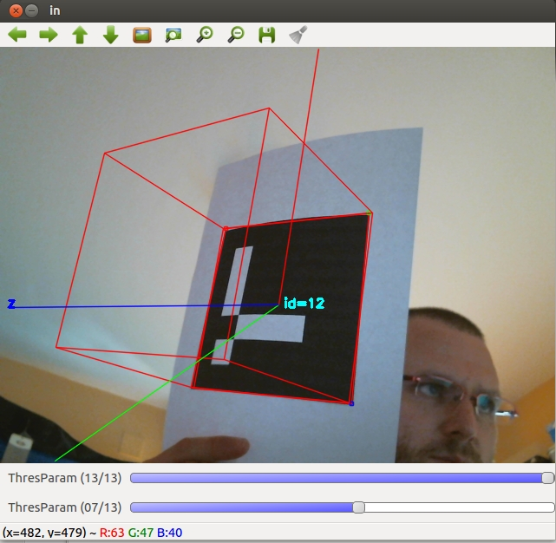
Applications
Used in Augmented Reality

Slide 27
THANKS!
Any questions?
You can find me at @dheerajkamath22@gmail.com

